Slide 1



Microsoft Technical Stock Analysis
Amit Bharadwa
Data Science Capstone Project
26th May 2020 cohort

Slide 2
The Problem
There are ≈ 630,000 companies on the stock market
It’s estimated 26,000 businesses a year went bankrupt between 2012-2017
There are a number of business who could have avoided bankruptcy if they acquired the right statistical knowledge
Who benefits from stock predictions?
Company owners
Investors
Shareholders
General Population

Slide 3
The Problem
There are two main kinds of stock analysis:
Fundamental analysis – Uses revenues, earnings, future growth, profit margins and other data to determine a company’s value.
Technical analysis – Which involves the study of historical market data to predict future price movements.
This project will focus on the Technical aspect of Microsoft stock data and other technology companies.
Can we use machine learning models to predict Microsoft’s next 30-day stock price?

Slide 4
Technical Factors Affecting the Stock Market
Supply and Demand
Inflation
Economic Strength of Market and Peers
Incidental Transactions
Trends
Liquidity
Market Sentiment

Slide 5
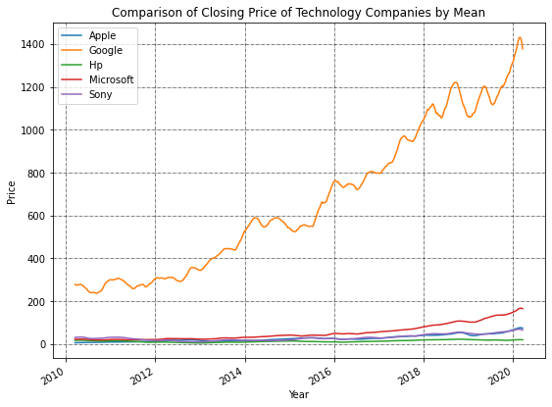
Stock Data
Data – Time Series data from Yahoo Finance
Timeframe- 1st January 2010 : 23rd March 2020
Features – High, Low, Open, Close, Volume, Adjusted Close
Included Companies – Apple(AAPL), Microsoft(MSFT), Sony(SNE), Google(GOOGL), HP(HPQ)
Figure 1: Comparison between each company based on 50-day rolling window for Adjusted Close price.

Slide 6
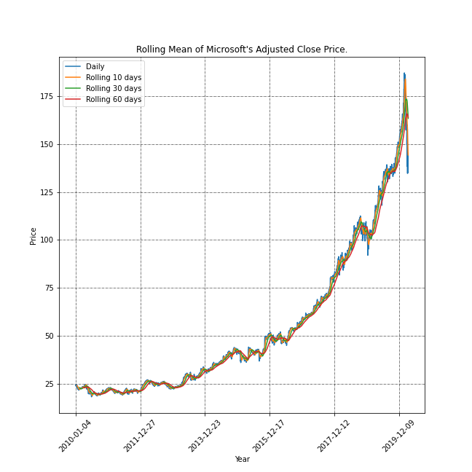
Exploratory Data Analysis
Figure 2: Adjusted Close price for Microsoft showing a general trend.

Slide 7
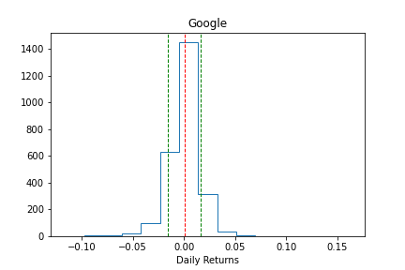
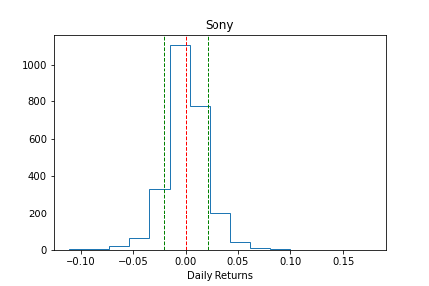
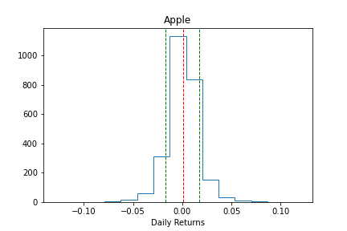
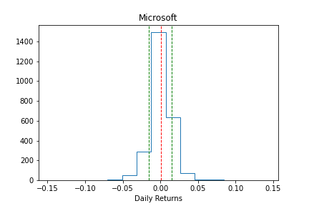
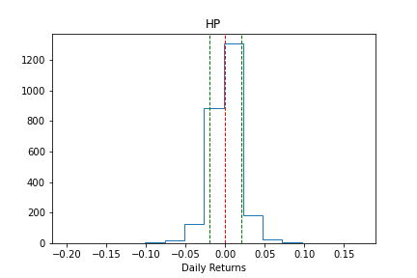
Exploratory Data Analysis
Returns =
Figure 3: All company returns following a normal distribution showing stationarity.

Slide 8
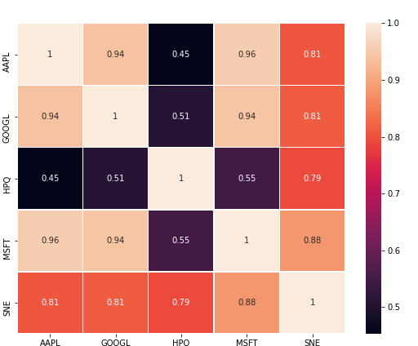
Exploratory Data Analysis
There seems to be a three companies showing a correlation with Microsoft > 0.8.
Apple : 0.96
Google: 0.94
Sony: 0.88
Figure 4: Heatmap showing correlation between each company

Slide 9
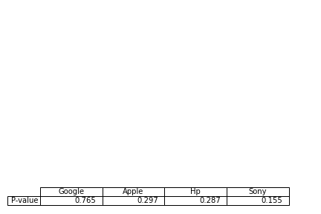
Cointegration Test
The Augmented Adfuller test was taken to see if there is cointegration between Microsoft and each company.
A P-value lower than 0.05 would be considered as statistically significant.
For further analysis, only Microsoft historical data will be taken into consideration.
Table 1: P-Value for Adfuller test

Slide 10
Machine Learning Modeling

Slide 11
Modeling Overview
Polynomial Linear Regression
XGBoost
ARIMA
Split: Time Series Split with Grid Search Cross Validation
Split: Time Series Split with Randomized cross validation
Split: Time Series Split with Randomized cross validation
Tools: Sklearn
Tools: xgboost
Tools: statsmodels

Slide 12
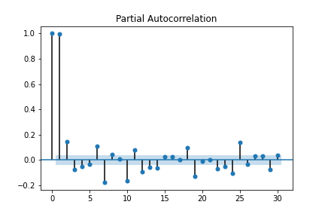
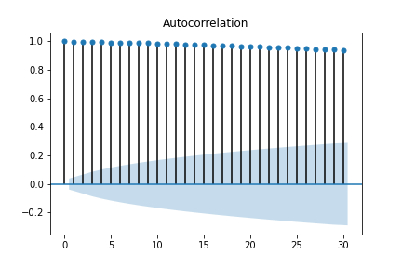
Preprocessing
ACF showing each time step is dependent on the previous time step
Figure 6: Partial autocorrelation function of time(day) lag of 30.
PACF showing the most significant timestep to predict the next time timestep is a one-day lag.
Figure 5: Autocorrelation function of time(day) lag of 30.

Slide 13
Modelling Steps
Data pre-processing:
Additional feature of a day lag added
Data split using Time Series Split (30-day test)
Data log normalized
Cross Validation (CV):
5-fold CV
Grid Search CV/ Randomized Search CV
Metrics: root mean square error (RMSE)
Modeling:
Linear Regression- Pipeline with Polynomial features/ walk forward validation
Comparison Metrics: RMSE and MAE

Slide 14
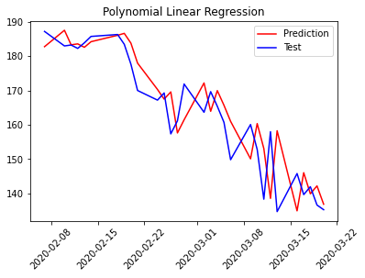
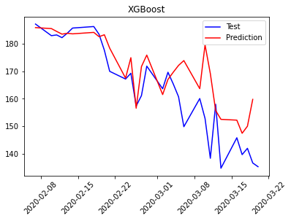
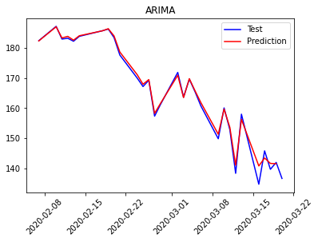
Model Comparisons
(a)
(b)
(c)
Figure 7: (a) Polynomial Linear Regression model predictions (b) XGBoost Regression model predictions (c) ARIMA model predictions
 | Polynomial Linear Regression | XGBoost Regression | ARIMA
MAE | 6.61 | 7.52 | 6.24
RMSE | 8.61 | 11.34 | 8.10

Slide 15
Best Model Details
Walk forward validation used to predict next timestep.
Parameters: p (periods taken for autoregressive model) = 2
d (order of integration) = 2
q (periods in moving average model) = 1

Slide 16
Assumptions and Limitations
Only four other technology companies were considered.
Limited to technical analysis, data for fundamental analysis would allow for better predictions.
Price movement of stocks is dependent upon supply and demand.
Price moves in trends

Slide 17
Conclusion
Only the Microsoft data set was used to forecast Microsoft future stock price
A lag of one day showed the most significant for predictions.
The data was split so that 30 days were left for prediction
ARIMA model (p=2,d=2,q=1), proved to be the best model with
RMSE = 8.10 and MAE = 6.24.
Future Work
Build a model with fundamental analysis features
Check for cointegration of more technology companies

Slide 18
Thank You!
Amit Bharadwa
Email: amit_123@hotmail.co.uk
Linkdin: https://www.linkedin.com/in/amit-bharadwa123/
Github: https://github.com/Amitdb123/Capstone-2

